Slide 1

Language Translation
A technology that bridges language barriers.
By Rahul Pandit
Sonu
Rajeev
Dev Rajoriya
RP

Slide 2
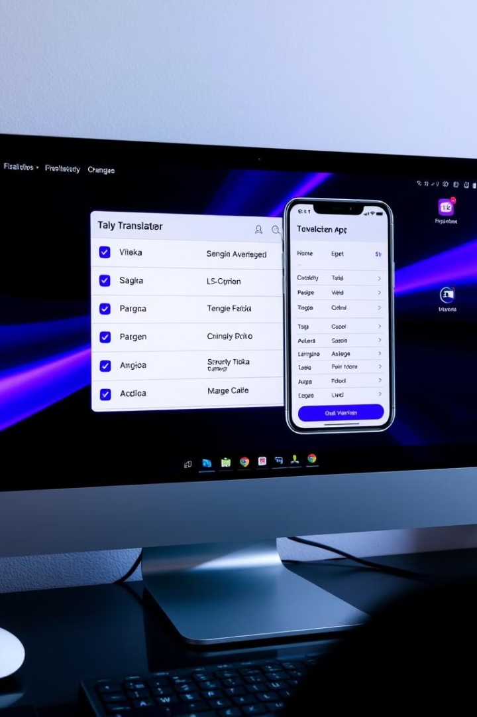
What is Language Translator?
A tool that converts text or speech from one language to another.
Text Translation
Converts written text.
There are many commonly used languages throughout the world, and the ability to exchange information between speakers of different languages is often a critical requirement for global solutions

Slide 3

Purpose of Language Translation
Facilitates communication and understanding between people who speak different languages.
1
Business
Expand global reach.
2
Education
Access knowledge in other languages.
3
Travel
Navigate unfamiliar environments.
4
Personal
Connect with loved ones.

Slide 4
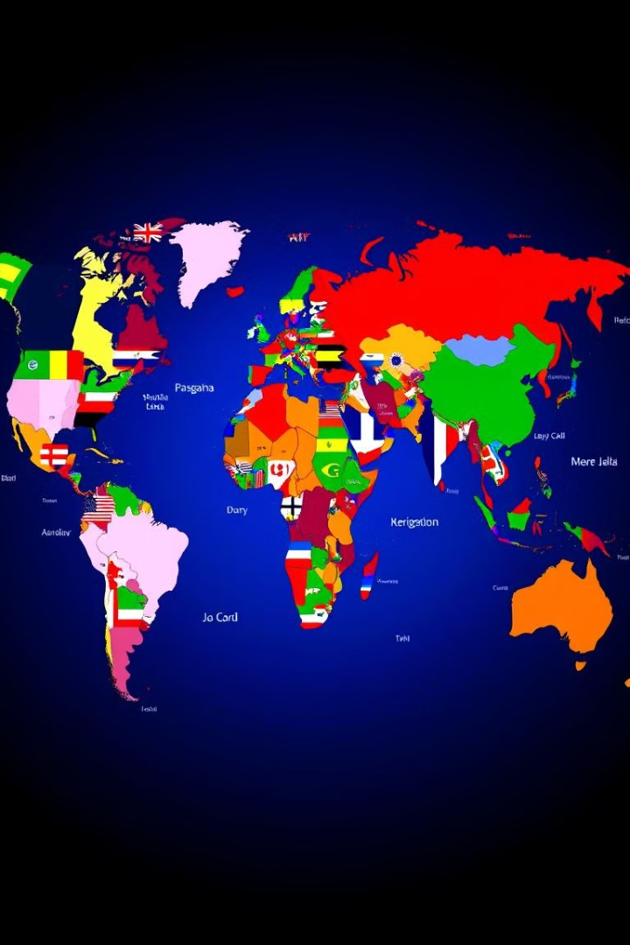
Supported Languages
Language translators support a wide range of languages.
English
Spanish
French
German
Chinese
Japanese
Russian
Arabic
Portuguese
+ 132 more languages

Slide 5
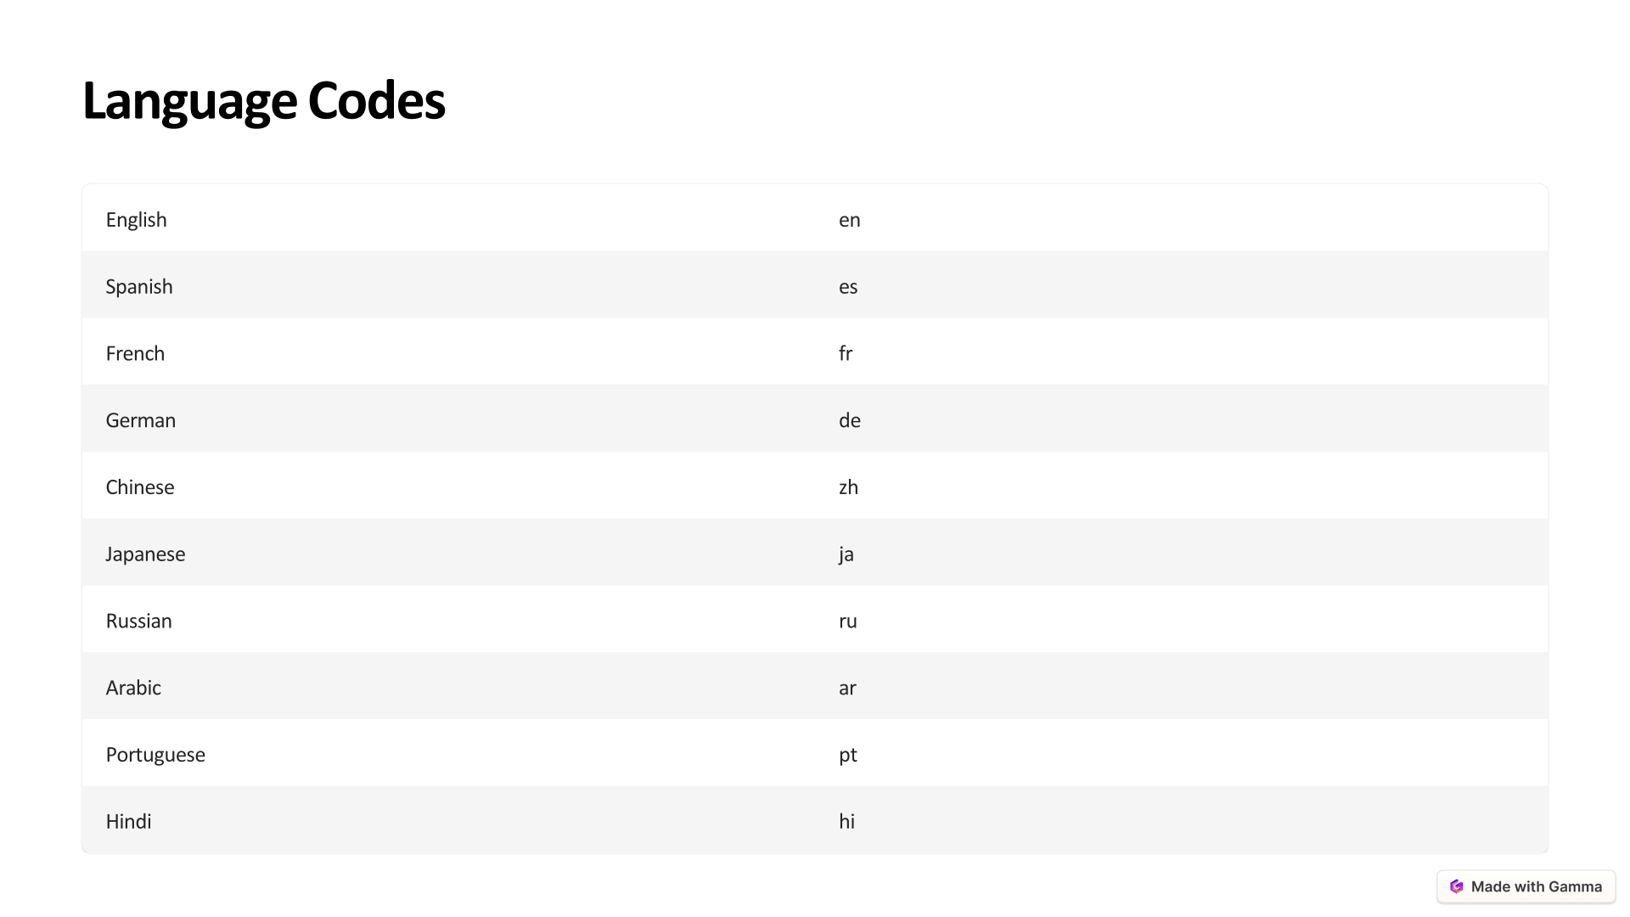
+125 More languages……

Slide 6
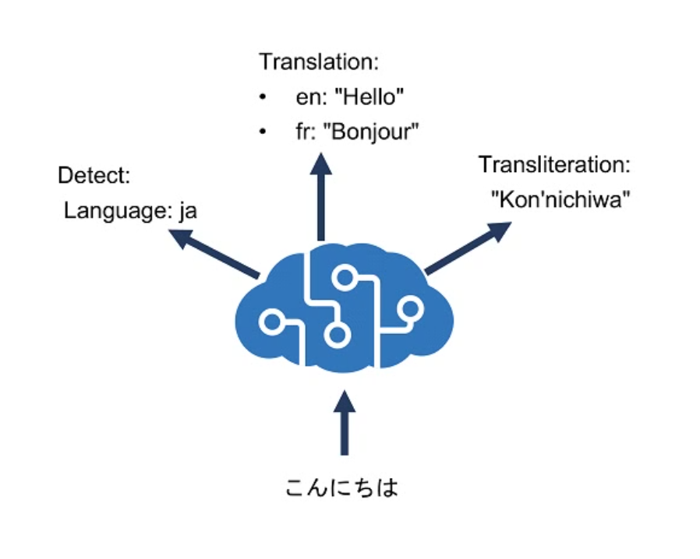
How it Works?

Slide 7

Implementing Azure Translator
Azure Translator is a cloud-based service.
1
Step 1
Create/Login Azure Account
2
Step 2
Create a Translator resource.
Paste Key, Endpoint and Region in .env file.
3
Step 3
Integrate the Translator API.
4
Step 4
Test & Deploy

Slide 8

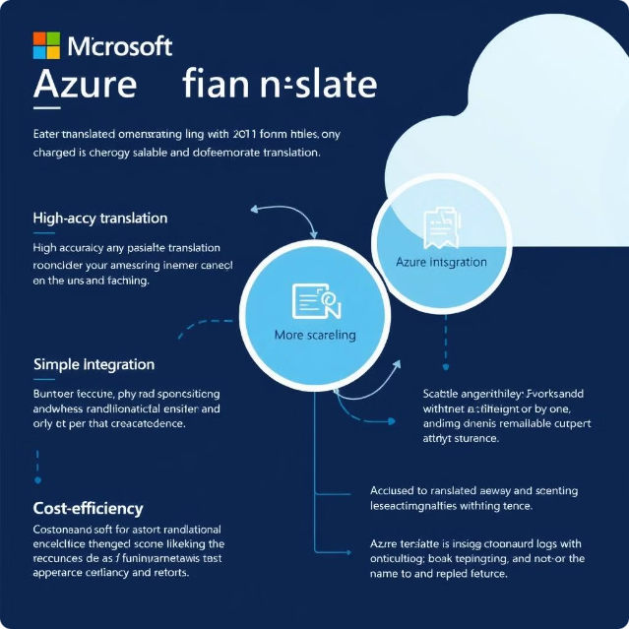
Advantages of Microsoft Azure
Azure Translator offers several advantages over other translation solutions.
First, Azure Translator is highly accurate and reliable.
Second, Azure Translator is easy to use and integrate into applications.
Third, Azure Translator is scalable and can handle large volumes of translation requests.
Finally, Azure Translator is cost-effective, offering a pay-as- you-go pricing model.

Slide 9
Advantages
Language translation offers several benefits.
Improved Communication
Increased Accessibility
Enhanced Collaboration
Break down language barriers.
Access information in other languages.
Work effectively with global teams.

Slide 10




Disadvantages
Language translation has some limitations.
Accuracy
May not always be perfect.
Nuance
Can lose cultural context.
Cost
Some services are paid.

Slide 11




Conclusion
Language translation is a powerful tool.
Communication
Facilitates understanding.
Globalization
Connects people worldwide.
Innovation
Continuously evolving.

